Slide 1


Analysis and Design of Algorithms
Transform Coding
Chapter 6: Decrease and Conquer
School of Software Engineering © Ye Luo

Slide 2
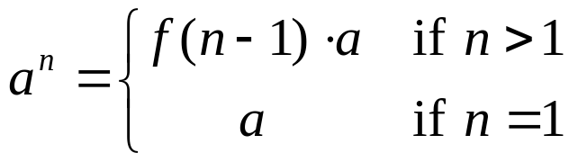
Decrease and Conquer
Three variations of Decrease and Conquer tech.
exploiting the relationship between a solution to a given instance of a problem and a solution to a smaller instance
  Decrease by a constant
  the size of the problem is reduced by the same constant on each iteration/ recursion of the algorithm.
  Eg.
  n !
  a^{n}=a*a^{n-1}
a problem of
size n
subproblem
of size n-1
a solution to the
subproblem
a solution to
the original problem

Slide 3
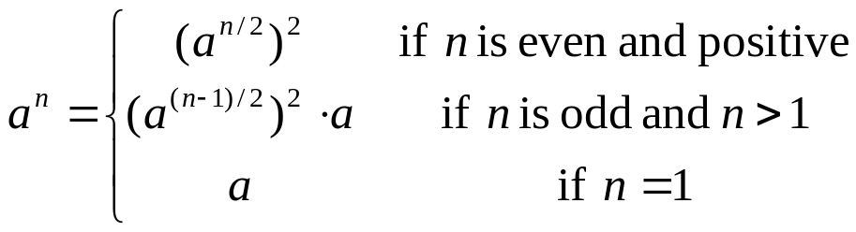
Decrease and Conquer
Three variations of Decrease and Conquer tech.
  Decrease by a constant factor (by half)
  the size of the problem is reduced by the same constant on each iteration/ recursion of the algorithm.
  Eg.
  a^{n}=(a^{n/2})²
problem of size n
subproblem
of size n/2
a solution to the
subproblem
a solution to
the original problem

Slide 4
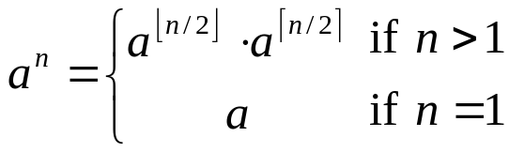
Decrease and Conquer
Three variations of Decrease and Conquer tech.
  for comparison: Divide and Conquer
a problem of size n
subproblem 1
of size n/2
subproblem 2
of size n/2
a solution to
subproblem 1
a solution to
subproblem 2
a solution to
the original problem

Slide 5
Decrease and Conquer
Three variations of Decrease and Conquer tech.
  Variable-size decrease
  the size reduction pattern varies from one iteration of an algorithm to another.
  Eg.
  Euclid’s algorithm
  gcd(m, n) = gcd(n, m mod n) iteratively while n≠0
  gcd(m, 0) = m

Slide 6
Decrease by One
Insertion Sort algorithm
Topological Sorting Algorithm

Slide 7
Insertion Sort
Insertion Sort algorithm
  idea
  assume that the smaller problem of sorting array A[0…n-2] has been solved to give a sorted array of size n-1: A[0…n-2]
  we can take advantage of this solution to the smaller problem to get a solution to the original problem, -------- to find an appropriate position for A[n-1] among the sorted elements A[0…n-2] and insert it there.
  Three ways to achieve it:
  scan the sorted subarray from left to right,
  ----- the first element >= A[n-1]
  ------ insert A[n-1] before the element Insertion Sort
  scan the sorted subarray from right to left,
  ----- the first element <= A[n-1]
  ------ insert A[n-1] after the element Insertion Sort
  use binary search to find appropriate position for A[n-1] in the sorted subarray binary Insertion Sort

Slide 8
Insertion Sort
Insertion Sort: an Iterative Solution
ALGORITHM InsertionSortIter(A[0..n-1])
//An iterative implementation of insertion sort
//Input: An array A[0..n-1] of n orderable elements
//Output: Array A[0..n-1] sorted in nondecreasing order
for i ← 1 to n – 1 do // i: the index of the first element of the unsorted part.
v = A[i]
j = i – 1 // j: the index of the sorted part of the array
while j >= 0 and A[j] > v do //compare the key with each element in the sorted part
A[j+1] ← A[j]
j ← j-1
A[j +1] ← key //insert the key to the sorted part of the array
Basic operation
A[0] < …. < A[ j ] < A[ j+1 ] < … < A[i-1] | A[i ] … A[n-1]
Smaller than or equal to A[i ] greater than A[i ]

Slide 9
Insertion Sort
  Example
1: 89| 45 68 90 29 34 17
2: 45 89| 68 90 29 34 17
3: 45 68 89| 90 29 34 17
4: 45 68 89 90| 29 34 17
5: 29 45 68 89 90| 34 17
6: 29 34 45 68 89 90| 17
7: 17 29 34 45 68 89 90
The vertical bar separates the sorted part of the array from the remaining elements
The element to be inserted is in bold.

Slide 10
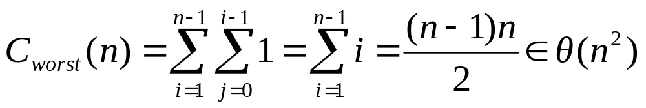
Insertion Sort
Analysis of Insertion Sort
  Worst-case:
  A[j] > v is executed for every j =i-1,..0
  If and only if A[j] > A[i] for j =i-1,..0
  i.e., the original input is an array of strictly decreasing values

Slide 11
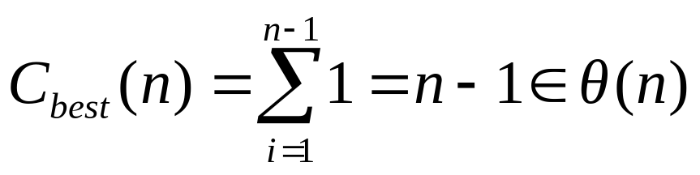
Insertion Sort
Analysis of Insertion Sort
  Best-case:
  A[j] > v is executed only once on every iteration
  If and only if A[i-1] <= A[i] for every for i =1,..n-1
  the original input is already sorted in ascending order
  Application: almost sorted files
  while sorting by quicksort, after subarrays become smaller than some predefined size, we can switch to using insertion sort
  -- typically decreases the total running time of quicksort by about 10%

Slide 12
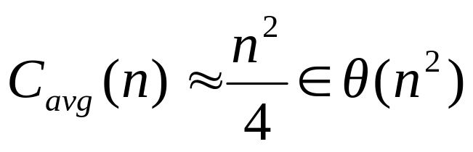
Insertion Sort
Analysis of Insertion Sort
  Average-case:
Selection Sort Θ (n ²) ; Bubble Sort Θ (n ²) ;
Shell Sort see Exer. 5.1 -10

Slide 13
Topological Sorting
problem
  Problem: Given a Directed Acyclic Graph(DAG) G = (V, E), find a linear ordering of all its vertices such that if G contains an edge (u, v), then u appears before v in the ordering.
  Example: Give an order of the courses so that the prerequisites are met
C4
Directed graph (digraph):
All edges with directions;
Adjacency matrix not have to be symmetric
C1
C3
  Being a dag is not only necessary but also sufficient for Topological Sorting to be possible
C2
C5
Is the problem solvable if the digraph contains a cycle?

Slide 14
Topological Sorting
DFS-Based method
    DFS traversal noting the order in which vertices are popped off stack (the order in which the dead end vertices appear)
    Reverse the above order
  Questions
  Can we use the order in which vertices are pushed onto the DFS stack (instead of the order they are popped off it) to solve the topological sorting problem?
  Does it matter from which node we start?
c₁
c₄
c₃
c₂
c₁
c₃
c₄
c₅
c₂
c₅
Notes:
https://www.cs.usfca.edu/~galles/visualization/TopoSortDFS.html
为什么在visit方法的最后将该顶点添加到一个集合中，就能保证这个集合就是拓扑排序的结果呢？
因为添加顶点到集合中的时机是在dfs方法即将退出之时，而dfs方法本身是个递归方法，只要当前顶点还存在边指向其它任何顶点，它就会递归调用dfs方法，而不会退出。因此，退出dfs方法，意味着当前顶点没有指向其它顶点的边了，即当前顶点是一条路径上的最后一个顶点。

Slide 15
复杂度分析
复杂度同DFS一致，即O(E+V)。
具体而言，首先需要保证图是有向无环图，判断图是DAG可以使用基于DFS的算法，复杂度为O(E+V)，而后面的拓扑排序也是依赖于DFS，复杂度为O(E+V)。

Slide 16
Topological Sorting
Source Removal method
  Based on a direct implementation of the decrease-by-one techniques.
  Repeatedly identify and remove a source vertex, ie, a vertex that has no incoming edges, and delete it along with all the edges outgoing from it.
c₁
c₄
c₄
c₄
c₃
Del C₁
Del C₂
c₃
c₃
c₂
c₅
c₂
c₅
c₅
c₄
Del C₃
  Topological Sorting problem may have several alternative solutions
c₅
c₅
Notes:
https://www.cs.usfca.edu/~galles/visualization/TopoSortIndegree.html

Slide 17
复杂度分析
初始化入度为0的集合需要遍历整张图，检查每个节点和每条边，因此复杂度为O(E+V);
然后对该集合进行操作，又需要遍历整张图中的每条边，复杂度也为O(E+V);
故总体算法复杂度为O(E+V)；

Slide 18
Decrease-by-a-Constant-Factor
Binary Search
Fake-Coin Problem
Russian Peasant Multiplication

Slide 19
Binary Search
Binary Search – a Recursive Algorithm
ALGORITHM BinarySearchRecur(A[0..n-1], l, r, K)
if l > r
return –1
else
m ← ⎣(l + r) / 2⎦
if K = A[m]
return m
else if K < A[m]
return BinarySearchRecur(A[0..n-1], l, m-1, K)
else
return BinarySearchRecur(A[0..n-1], m+1, r, K)
Basic operation:
while循环中k与A 中元素的比较运算
three-way comparison

Slide 20
Binary Search
Analysis of Binary Search
  Basic operation: key comparison (three-way comparison )
  Worst-case (successful or fail) :
  C_{w} (n) = C_{w}( ⎣n/2⎦ ) + 1 ,
  C_{w} (1) = 1
  Solution:
  C_{w}(n) = Θ (logn)
  Best-case:
  successful C_{b} (n) = 1
  一次找到，即K＝A[n/2]
for n =2^{k},
C(2^{k}) = C (2^{k-1}) +1 for k>0
C(2⁰) = 1
backward substitutions:
C (2^{k}) = C (2^{k-1}) +1
= [C(2^{k-2}) +1] + 1
= C (2^{k-2}) +2 =...= C (2^{k-i}) +i ...
= C (2^{k-k}) +k= 1+k
then, C(n) = log₂n +1
Notes:
每执行一次算法的while循环， 待搜索数组的大小减少一半。因此，在最坏情况下，while循环被执行了O(logn) 次。循环体内运算需要O(1) 时间，因此整个算法在最坏情况下的计算时间复杂性为O(logn) 。

Slide 21
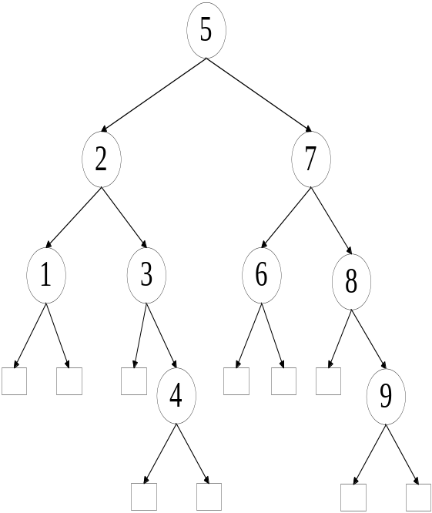
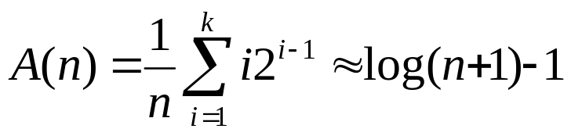
Binary Search
Analysis of Binary Search
  Average-case:
  Consider the searching process as a binary tree. In looking at the binary tree, we see that there are i comparisons needed to search 2^{i-1} elements on level i of the tree.
  For a list with n = 2^{k}-1 elements, there are k levels in the binary tree.
  The average case for all successful search:

Slide 22
Fake-Coin Problem
Problem: Among n identical-looking coins, one is fake. With a balance scale, we can compare any two sets of coins.
That is, by tipping to the left, to the right, or staying even, the balance scale will tell whether the sets weigh the same or which of the sets is heavier than the other but not by how much.
The problem is to design an efficient algorithm for detecting the fake coin. An easier version of the problem—the one we discuss here—assumes that the fake coin is known to be, say, lighter than the genuine one

Slide 23
Fake-Coin Problem
Idea 1: Decrease by half
Step1: To divide n coins into two piles of n/2 coins each, leaving one extra coin aside if n is odd, and put the two piles on the scale.
Step2: If the piles weigh the same, the coin put aside must be fake;
Step3: Otherwise, we can proceed in the same manner with the lighter pile, which must be the one with the fake coin.

Slide 24
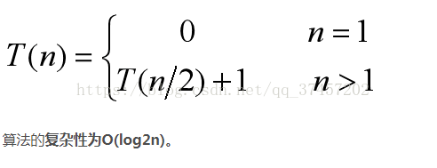
Fake-Coin Problem
Complexity:

Slide 25
Fake-Coin Problem
Idea 1: Decrease by a third
Step1: To divide n coins into three piles. The first two piles with n/3 coins each, and all the left as the third pile. Put the two piles on the scale.
Step2: If the two piles weigh the same, the fake coin must be in the third pile;
Step3: Otherwise, we can proceed in the same manner with the lighter pile, which must be the one with the fake coin.

Slide 26
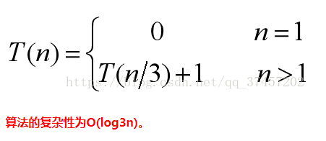
Fake-Coin Problem
Complexity:

Slide 27
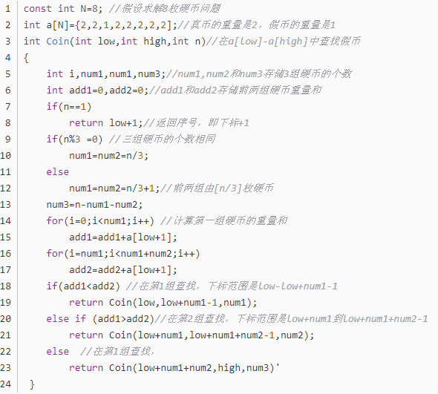
Fake-Coin Problem

Slide 28
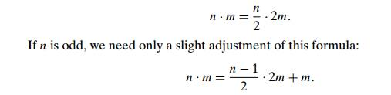
Russian Peasant Multiplication
Problem: Let n and m be positive integers whose product we want to compute, and let us measure the instance size by the value of n. Now, if n is even, an instance of half the size has to deal with n/2, and we have an obvious formula relating the solution to the problem’s larger instance to the solution to the smaller one:
Using these formulas and the trivial case of 1 . m = m to stop.
We can compute product n . m either recursively or iteratively.

Slide 29
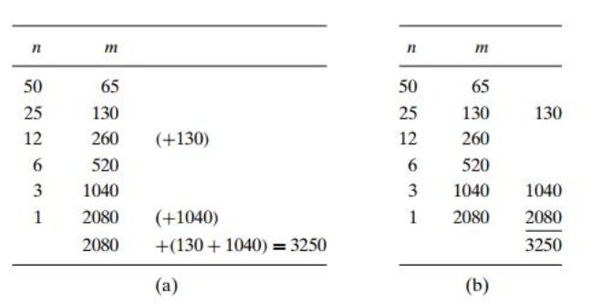
Russian Peasant Multiplication
An example of computing 50 . 65 with this algorithm
What’s the time complexity of this algorithm? Which one is an iterative algorithm?
Notes:
https://www.brainkart.com/article/Decrease-by-a-Constant-Factor-Algorithms_8019/
Note that all the extra addends shown in parentheses in (a) are in the rows that have odd values in the first column. Therefore, we can find the product by simply adding all the elements in the m column that have an odd number in the n column (Figure 4.11b).

Slide 30
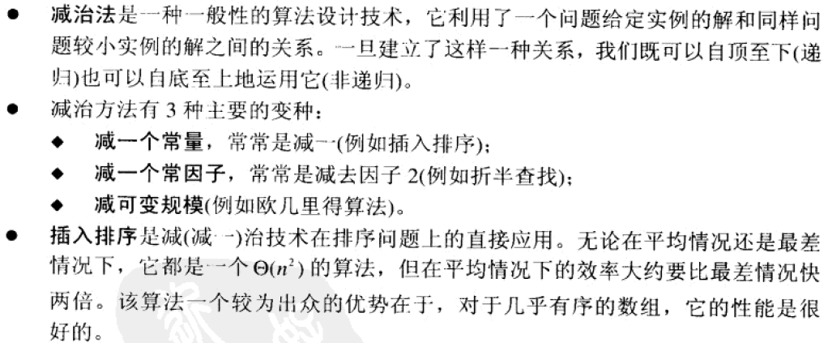

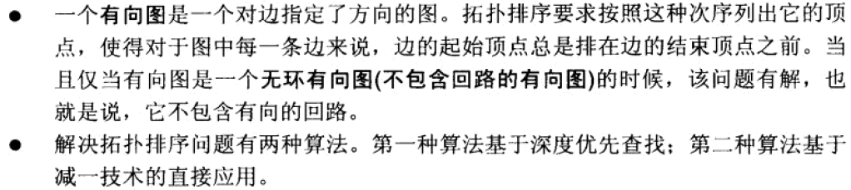
Summary

